Slide 1
From 2D Keypoints to 4D Humans
Yiqiao Liu
Taijia Liang
Intro to CV
CSCI-GA.3033-076

Slide 2
Related Work & Methodology
Notes:
Wu et al. show that ML can predict how performance scales across GPU configurations. Zigon et al. use ML to classify kernels from performance counters. Liu et al. build regression models that identify the most important GPU hardware features. And Lee et al. introduce NeuSight, which predicts deep-learning kernel performance on unseen GPUs by modeling fundamental compute and memory behavior.
We noticed that few models jointly capture both kernel-level structure and hardware characteristics. This lack motivates our project.

Slide 3
01 · 2D POSE ESTIMATION · BOTTOM-UP
Cao et al. · TPAMI 2019
OpenPose
01
Part Affinity Fields
Per-pixel 2D vectors aligned along each limb's direction — the network outputs PAFs alongside keypoint heatmaps.
02
Bottom-up association
Detect every keypoint first, then bipartite-match to people via PAF scores. No per-person crop.
03
O(1) inference vs number of people
Real-time multi-person at 22 fps — runtime independent of crowd size.
Yiqiao
Limit: precision capped by heatmap resolution → HRNet attacks this. HMR consumes the 2D output.

Slide 4
02 · 3D BODY RECOVERY · SINGLE-PASS REGRESSION
Kanazawa et al. · CVPR 2018
HMR
60 s → ~100 ms
iterative SMPLify → one forward pass · measured on RTX PRO 6000
01
02
03
Single-pass regression
Reprojection loss
Adversarial body prior
Image → 82-d SMPL params (72 θ + 10 β) + camera.
3D joints projected back to 2D, supervised by HRNet/OpenPose-style detections.
Discriminator on 4M Mocap poses keeps outputs anatomically plausible.
Yiqiao
Key insight — the 2D papers are not HMR's competitors; they are its training signal.

Slide 5

03 · 2D POSE ESTIMATION · TOP-DOWN · HIGH RESOLUTION
Sun et al. · CVPR 2019
HRNet
01
Parallel multi-resolution
Branches at 4 scales fuse continuously — high-res stream is never lost.
02
Top-down pipeline
Detector first, then per-person crop · cost grows with #people.
03
Wins on small joints
Crisp wrists / ankles / toes — exactly what HMR's reprojection loss leans on.
Our HRNet output · yoga photo · notice the wrist / ankle precision
Taijia
Two complementary endpoints of the 2D paradigm — bottom-up speed vs top-down precision.

Slide 6
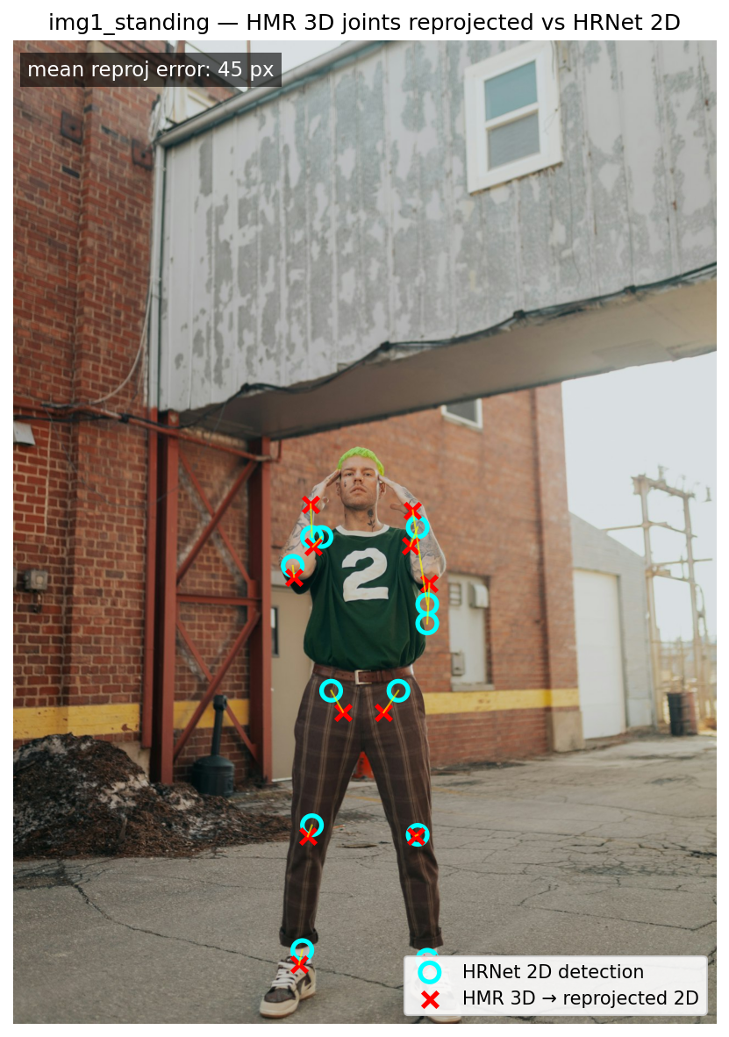
THE BRIDGE · SMPL + REPROJECTION LOSS
From 2D to 3D
SMPL M ( θ , β ) · 72-d pose + 10-d shape → 6890-vertex mesh
OpenPose + HRNet
produce 2D keypoints
HMR
predicts 3D joints
Project back to 2D
weak-perspective camera
L2 vs HRNet 2D
→ reprojection loss
Our HMR 3D joints (×) reprojected vs HRNet 2D (○)
Taijia
★ The 2D papers are HMR's training signal — not its competitors.

Slide 7
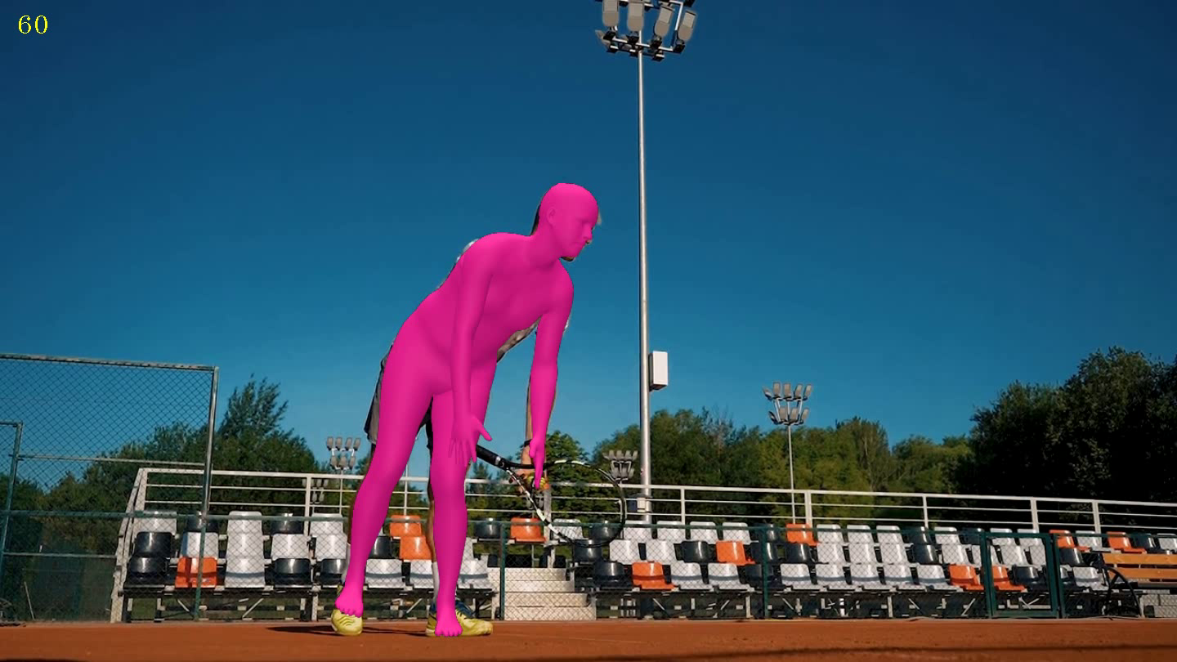
HMR 2.0 + PHALP · ADDING THE TIME AXIS
From 3D to 4D
2018
2022
2023
HMR
PHALP
HMR 2.0
single image
video tracking
ViT backbone
4D = 3D + time
No new mechanism — per-frame HMR 2.0 stitched by PHALP's tracking. Output isn't a video; it's a per-frame SMPL time-series ready for biomechanics.
PHALP frame @ 2.0 s · HMR 2.0 mesh on track 1
Taijia

Slide 8
Preliminary Results
Notes:
Wu et al. show that ML can predict how performance scales across GPU configurations. Zigon et al. use ML to classify kernels from performance counters. Liu et al. build regression models that identify the most important GPU hardware features. And Lee et al. introduce NeuSight, which predicts deep-learning kernel performance on unseen GPUs by modeling fundamental compute and memory behavior.
We noticed that few models jointly capture both kernel-level structure and hardware characteristics. This lack motivates our project.

Slide 9
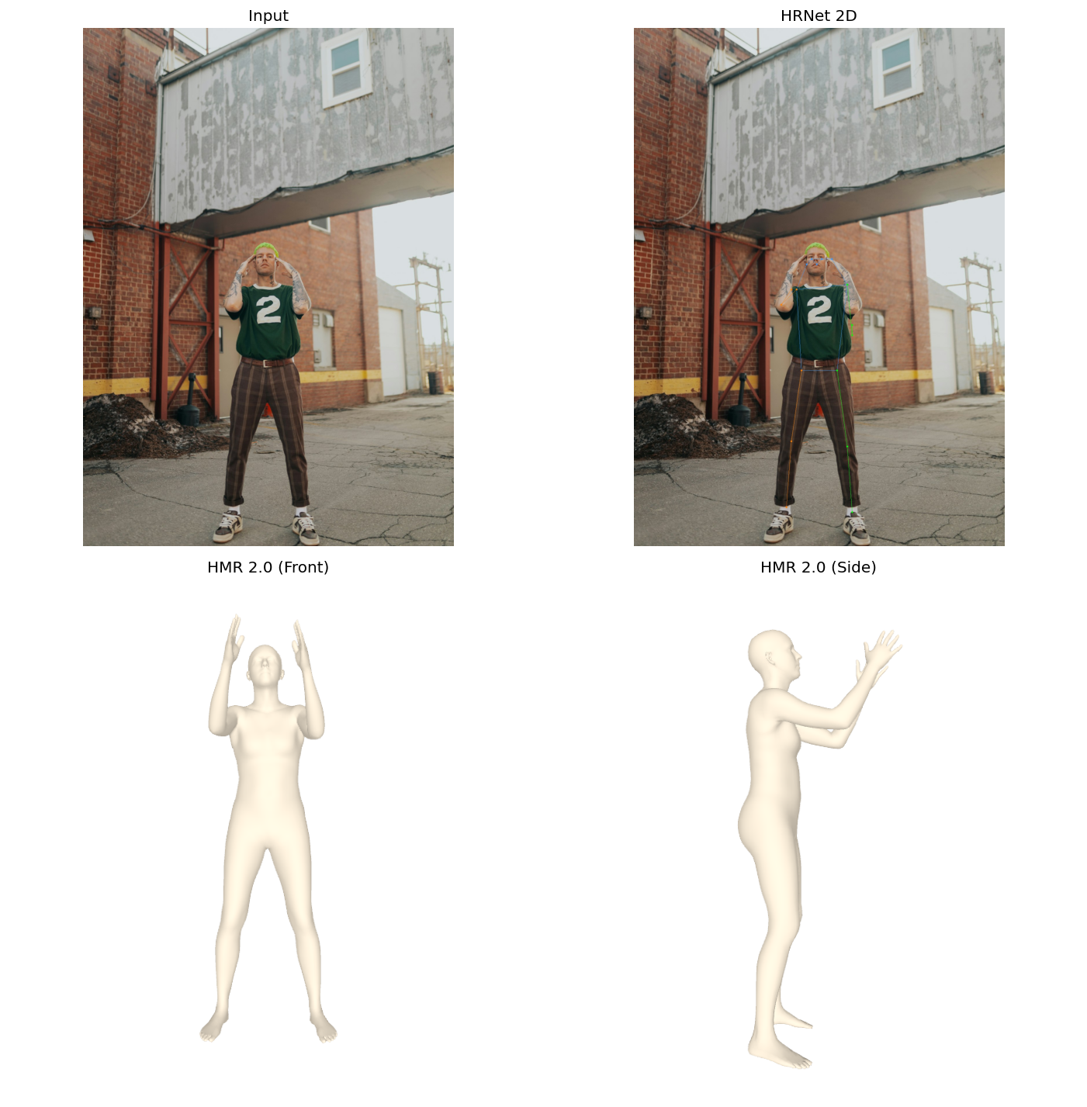
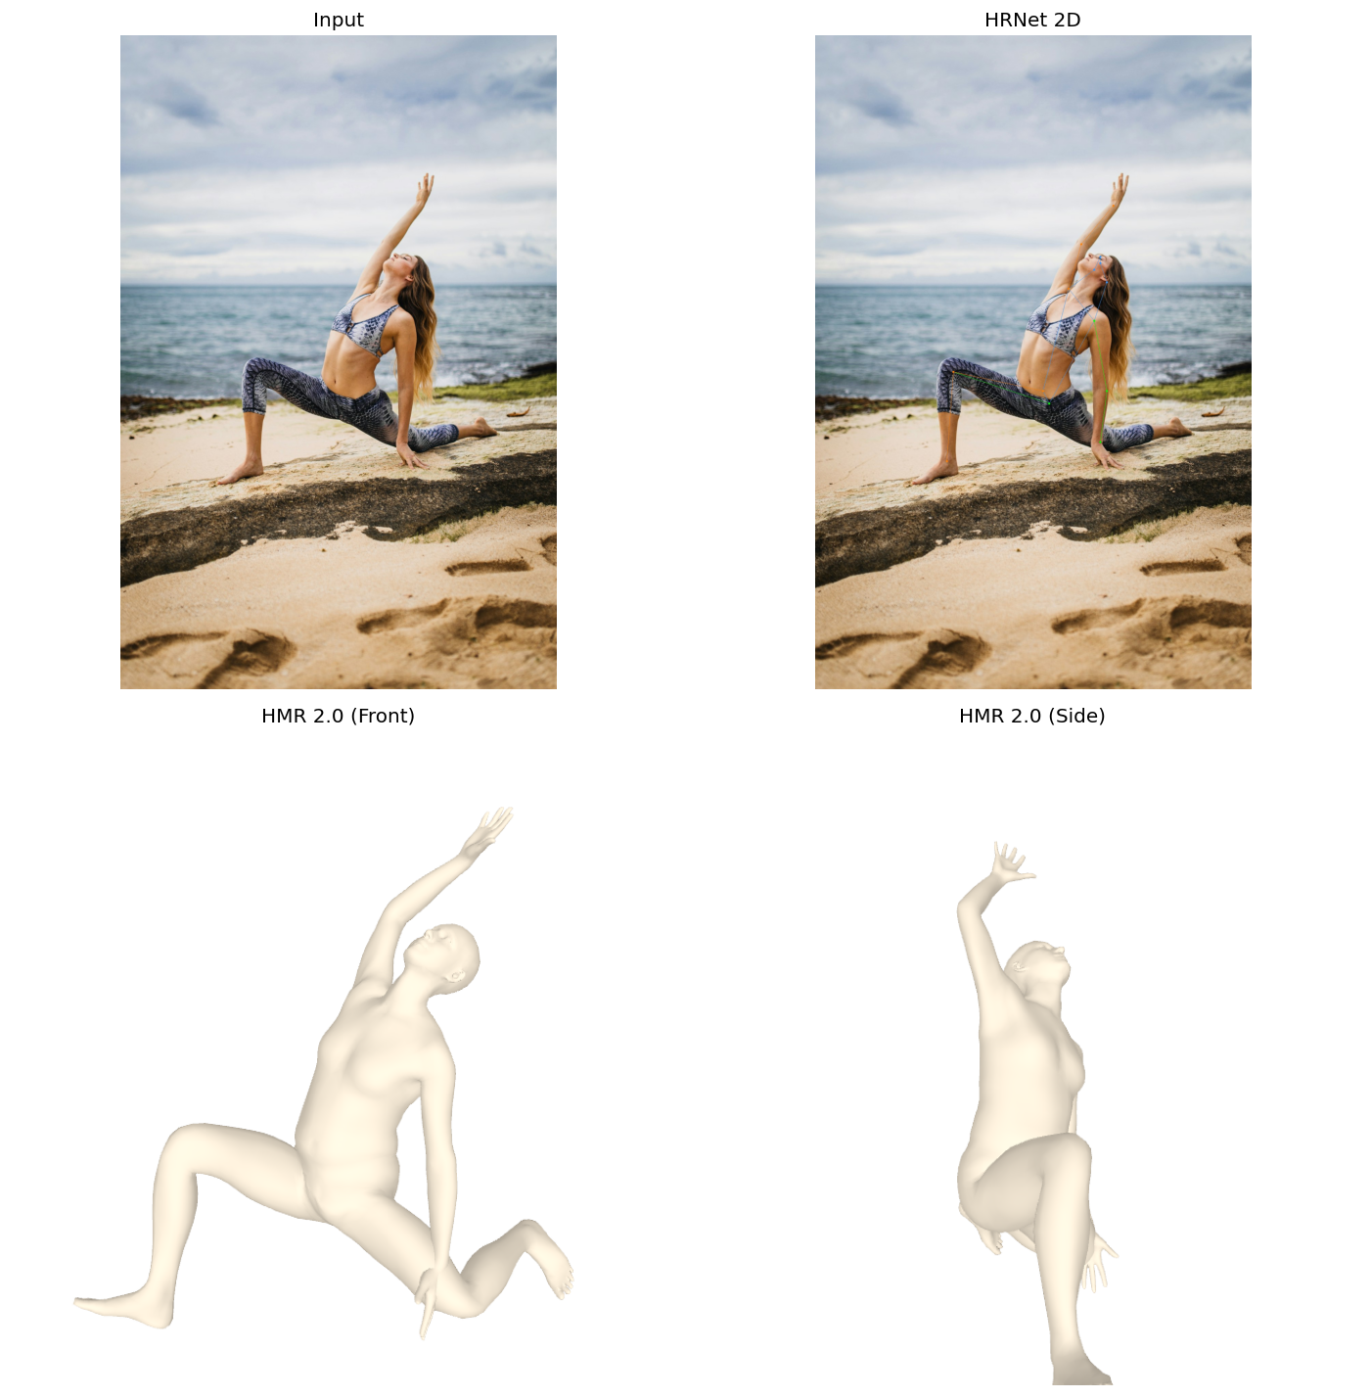
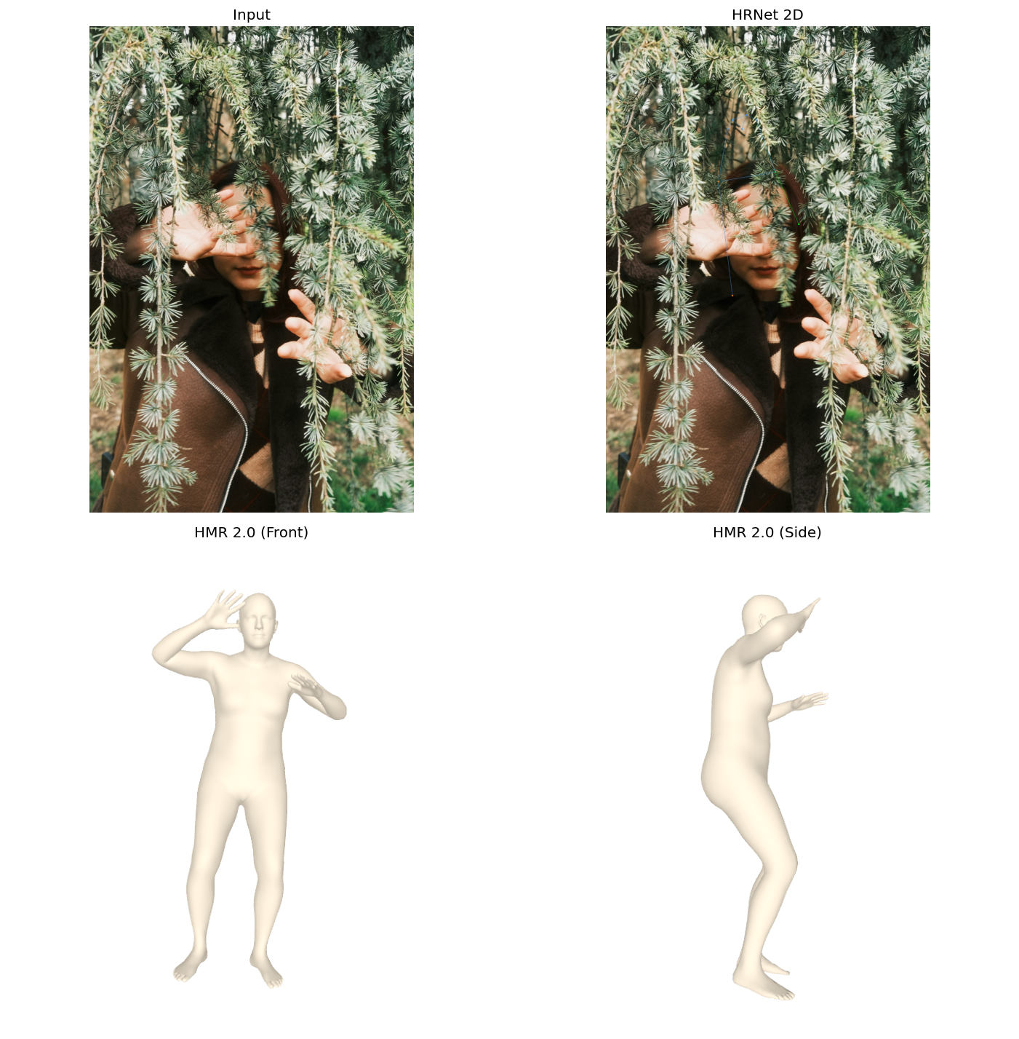
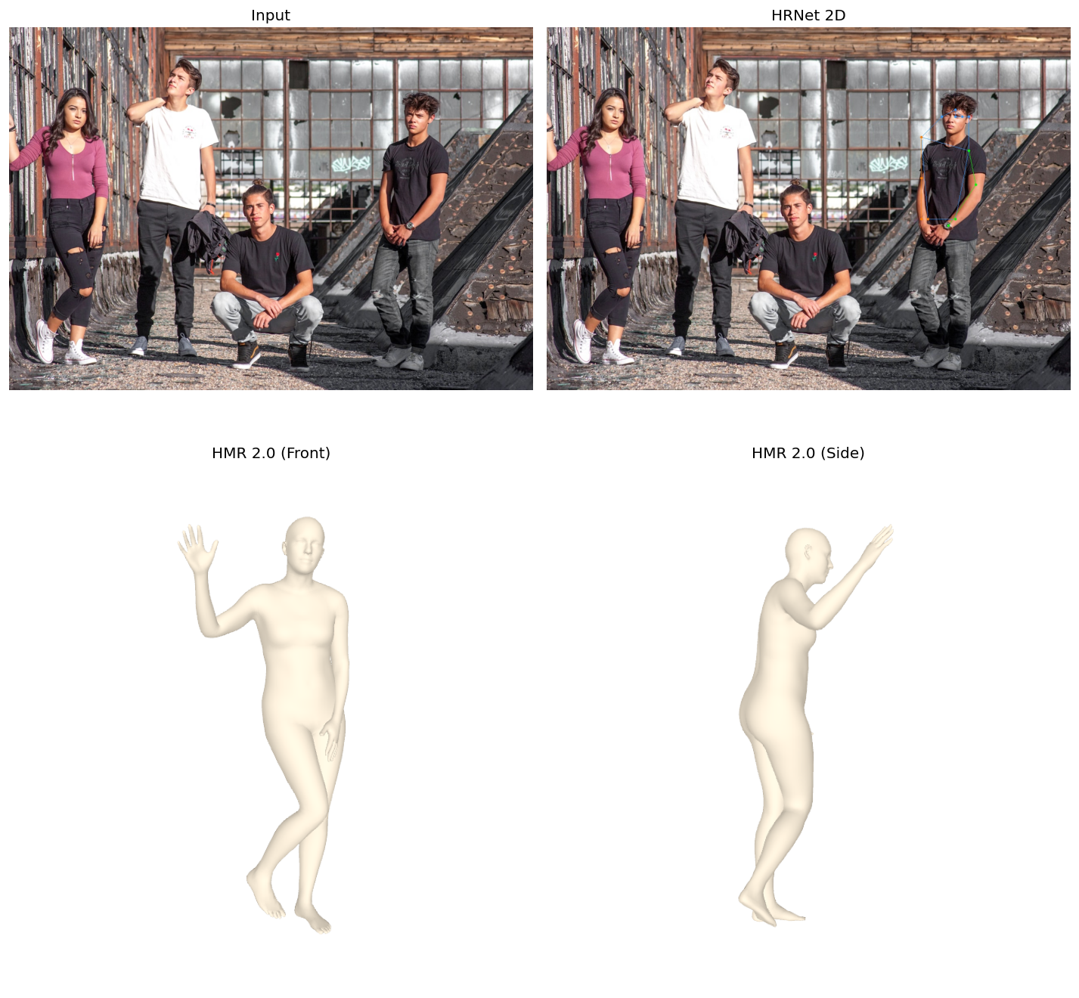
LIVE DEMO · 4 IN-THE-WILD PHOTOS
Image pipeline
each panel: input → HRNet 2D → HMR 2.0 (front) → HMR 2.0 (side) · ~100 ms / image
Standing
Yoga
Occluded
Multi-person
baseline
prior holds
prior fills
top-down crop
Taijia
Same forward pass. No per-image tuning. No iteration.

Slide 10
LIVE DEMO · 8.6 S TENNIS SERVE
Video pipeline
216 frames
every frame · one HMR 2.0 forward pass
1
Same HMR 2.0 used on each frame
2
Tracking re-IDs the player across motion blur
3
Output: structured 3D time-series — biomechanics-ready
tennis_clip.mp4 · 5 s loop · double-click in PowerPoint to play
Taijia
The valuable output isn't the video — it's the data behind it.

Slide 11
Analysis, Limitations & Next Steps
Three take-aways · three honest limitations · three forward directions
01
TAKE-AWAYS
• 2D papers supervise the 3D paper.
• Single-pass paradigm wins everywhere except absolute precision.
• Adding the time axis is the natural next step, not a new field.
02
LIMITATIONS TODAY
• Per-frame jitter and global scale drift in video.
• 3D ground truth is scarce — in-the-wild domains are narrow.
• Mesh surfaces lack clothing, hair, soft tissue.
03
WHAT COMES NEXT
• VIBE / SLAHMR — temporal smoothing + global camera.
• Sapiens (Meta 2024) — human foundation model.
• 3DGS-Avatar — neural / Gaussian surfaces.
Taijia
Notes:
Wu et al. show that ML can predict how performance scales across GPU configurations. Zigon et al. use ML to classify kernels from performance counters. Liu et al. build regression models that identify the most important GPU hardware features. And Lee et al. introduce NeuSight, which predicts deep-learning kernel performance on unseen GPUs by modeling fundamental compute and memory behavior.
We noticed that few models jointly capture both kernel-level structure and hardware characteristics. This lack motivates our project.

Slide 12
Thank you

